Slide 1
Jousting Robot Project
With Wireless Controller
Suffolk University
Ximing He
Notes:
This presentation is supposed to last 15 minutes long. As some of you might have seen my project before, here I am going to spend 5 minutes to briefly go over my design, and use 10 minutes to let you try on combating.

Slide 2
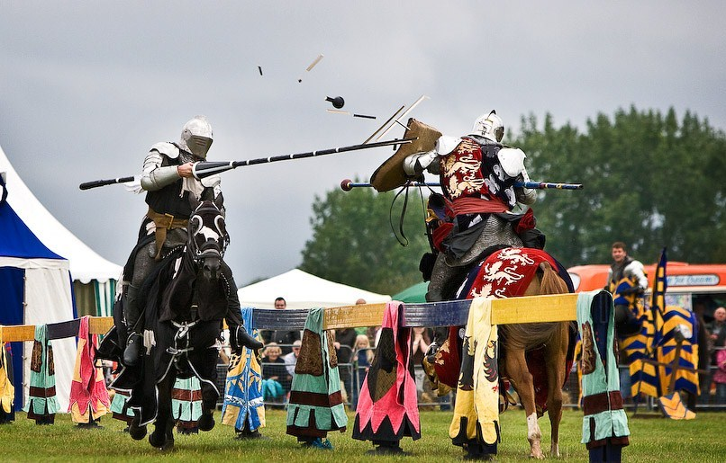
What is Jousting?
a competition between two horsemen wielding lances with blunted tips
Notes:
"A picture is worth a thousand words." Jousting is a Medieval competition between two heavy cavalries who wield their lances and try to strike the opponent out of the horseback.
Credit: http://www.knightsofmiddleengland.com/jousting-displays/

Slide 3
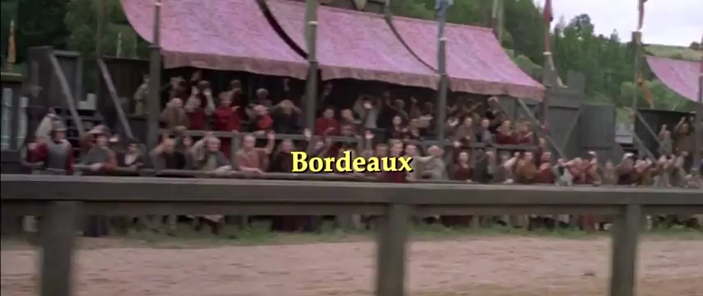
A Knight's Tale movie clip
Credit: https://youtu.be/jamZyBva_LE?t=3m12s
Notes:
A video is worth a thousand pictures. I have a video that shows you exactly what jousting looks like.

Slide 4
What is needed for mimicking the competition?
Knight
Lance
Horse
a martial game between two horsemen wielding lances with blunted tips
Notes:
What do we need for mimicking the competition of jousting? Basically, we need 3 major components.
Credit: http://www.knightsofmiddleengland.com/jousting-displays/

Slide 5
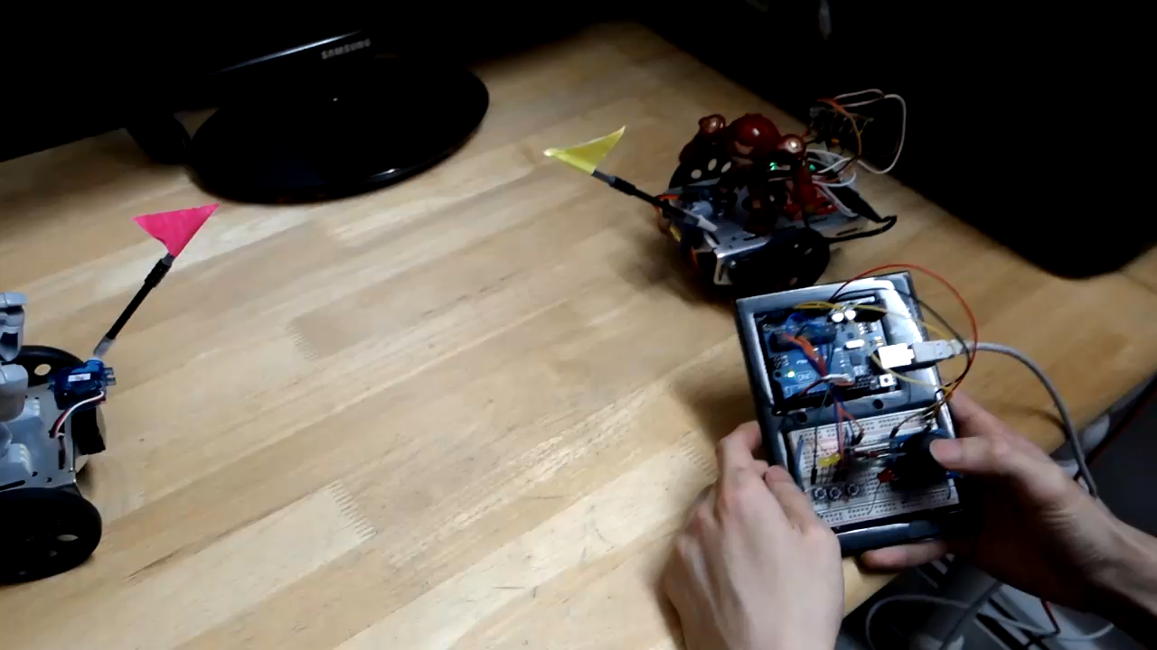
Prototype Demo
Notes:
https://youtu.be/7JnDcMdfs3Y

Slide 6
Jousting Robot
Purpose:
Platform:
Language:
Wireless:
Control:
Power:
Recreational
Arduino
C++
Xbee (IEEE 802.15.4)
Push button + Joystick
Batteries

Slide 7
Parts & Cost
Arduino UNO 4 × $20 = $80
Xbee + adapter 4 × $30 = $120
Breadboard 4 × $5 = $20
Servo 8 × $5 = $20
Joystick 2 × $10 = $20
Push Button 6 × $0 = $0
Miscellaneous $10
Total $290

Slide 8
Source Codes
Controller:
https://drive.google.com/open?id=0B4rMGXbqflW4UVJpUFRFeXZLUms
or https://goo.gl/kRxTOH
Robot Body:
https://drive.google.com/open?id=0B4rMGXbqflW4TmNBMF9oaUpJR3c
or https://goo.gl/apuxbV

Slide 9


Controller Manual
Moving Base
Swinging Lance

